Slide 1
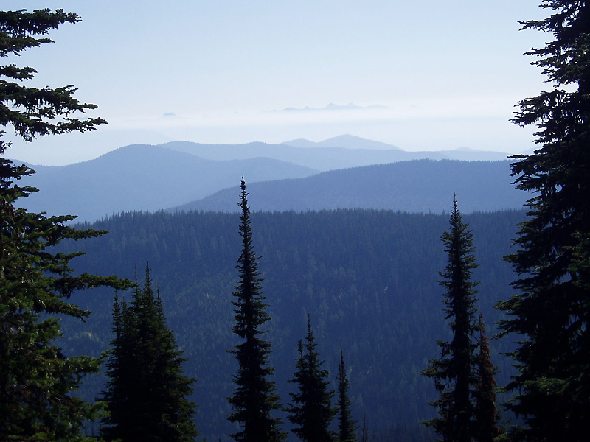
Integrated Restoration
Theresa “Terrie” Jain
Russell Graham

Slide 2
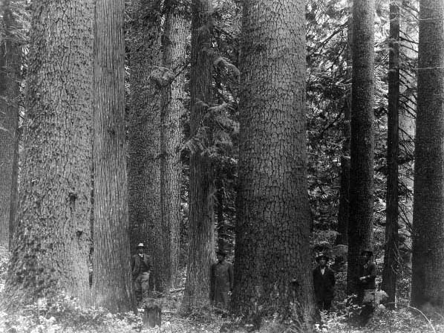
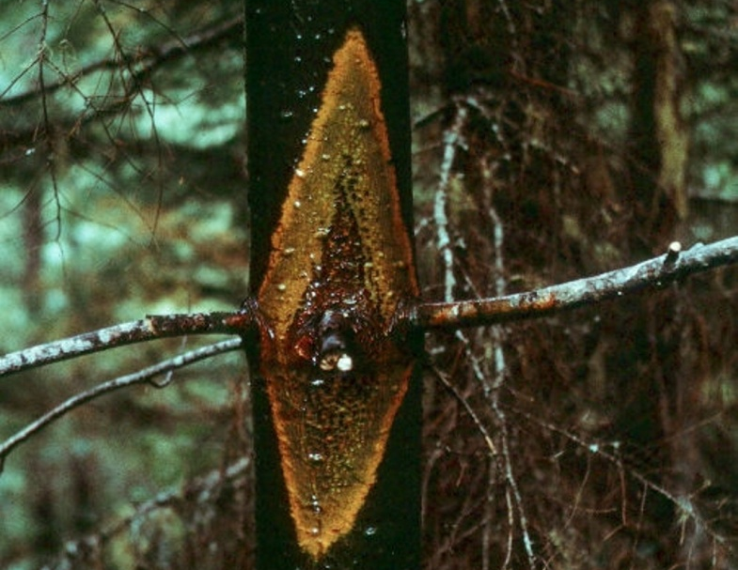
3
Stories

Slide 3
Northern Rocky Mountain Moist Forests

Slide 4
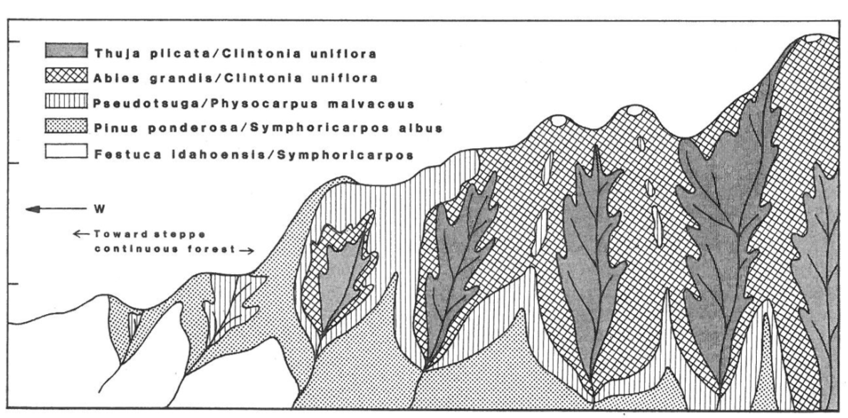
Topographically Diverse
Upland western redcedar
True fir
Douglas-fir
Ponderosa pine
Grass/shrub
From Daubenmire 1980 Topographic Relationships of Habitat Types
Notes:
Species will be most resilient in the best sites for the species- sites will expand and contract dependant on conditions. With reduced moisture availability, expect the drier ends to expand, the moist middle to contract and the upper may move downward if moisture does not compensate for increased temperatures. Change in species preferences on the ecotones based on these conditions.

Slide 5
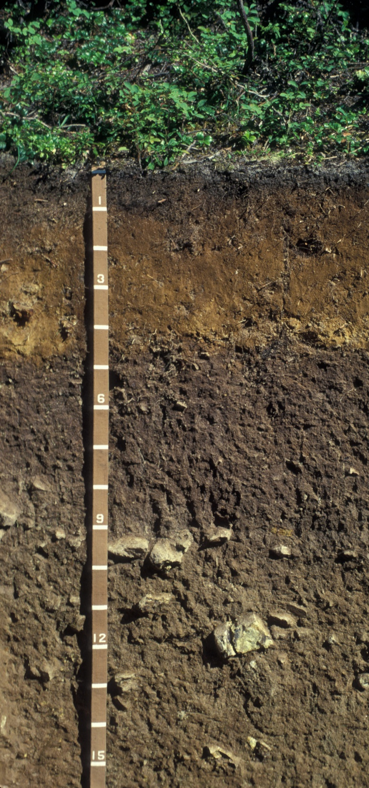
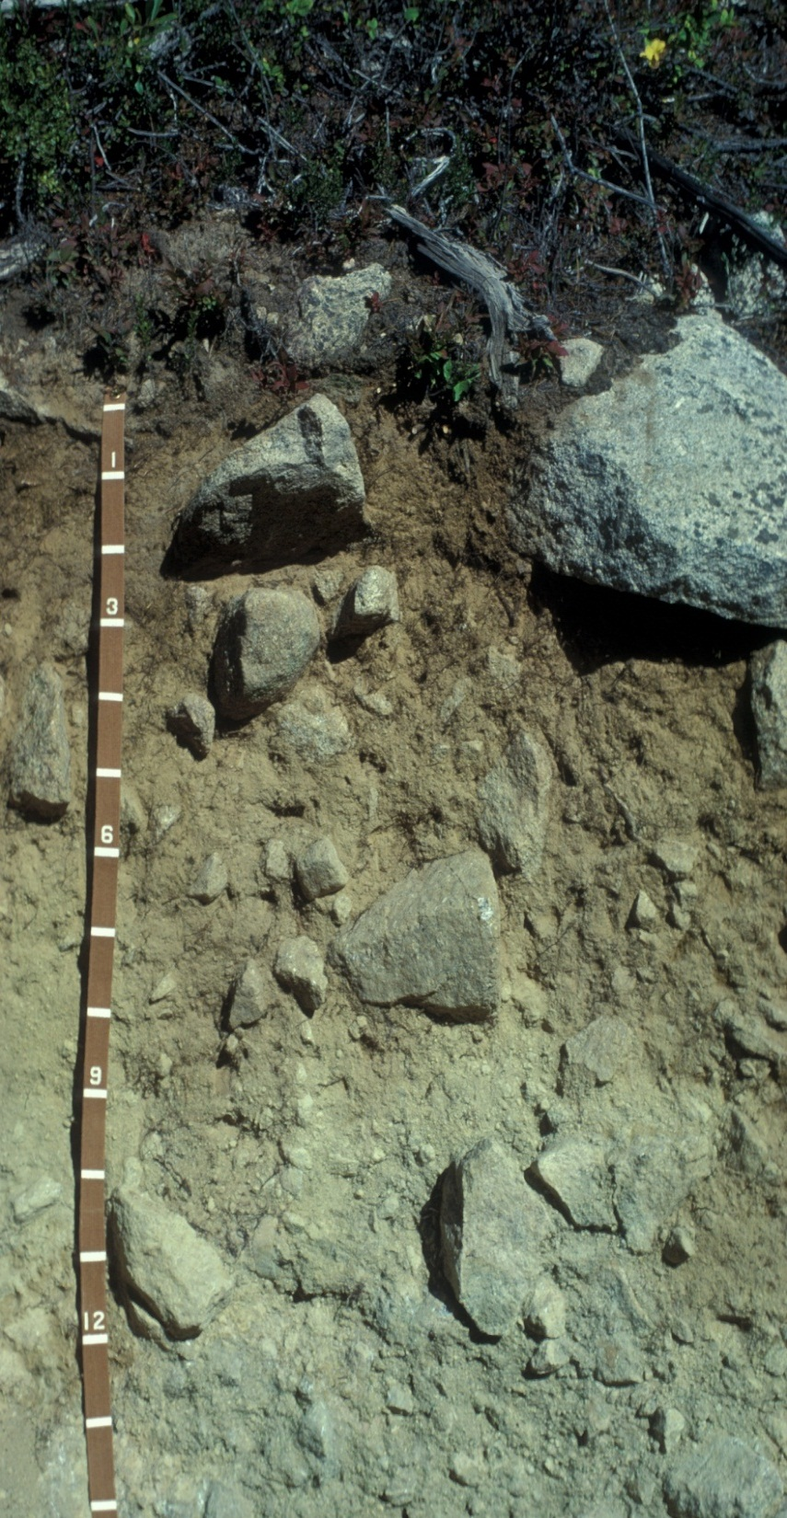
Soils

Slide 6
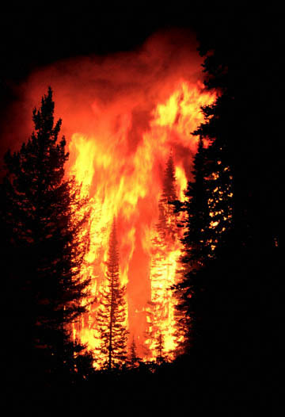
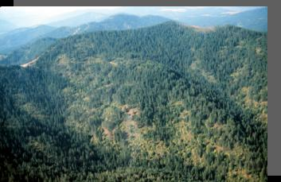
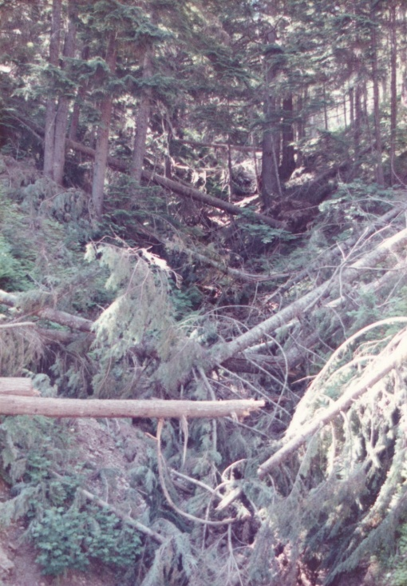
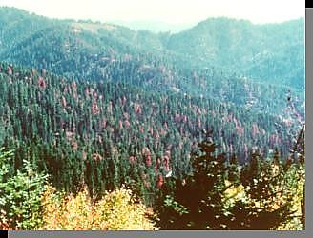
Disturbances
Diseases
Climate
Mixed & Variable
Fire Regime
Storms
Insects
Notes:
Disturbance driven ecosystem – fire only one of several disturbances interacting together

Slide 7
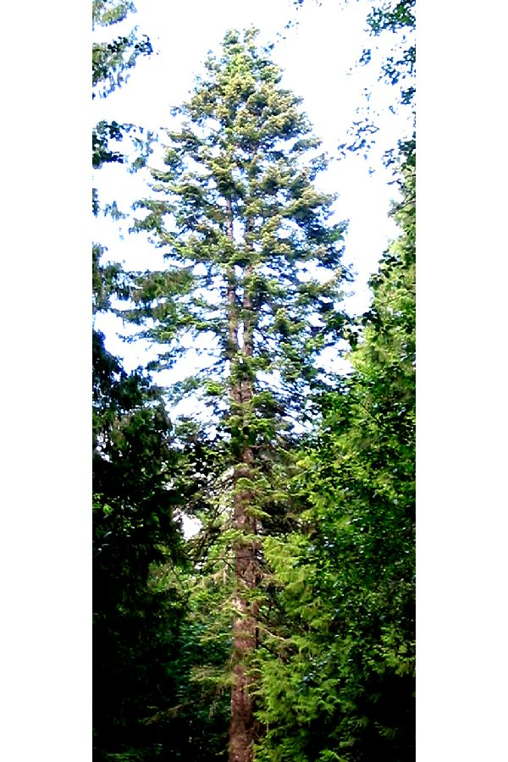
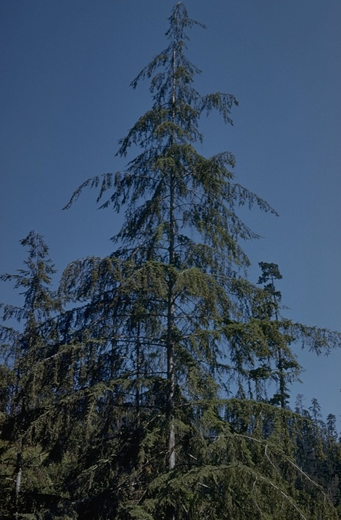
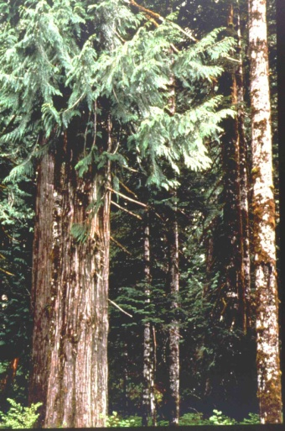
Diverse Vegetation
Species
Age
Size
Single story
Multiple stories
White Pine
Western Larch
Ponderosa
Pine
Western
Redcedar
Grand Fir
Douglas Fir
Western hemlock

Slide 8
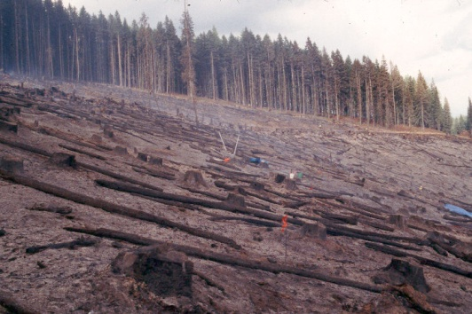
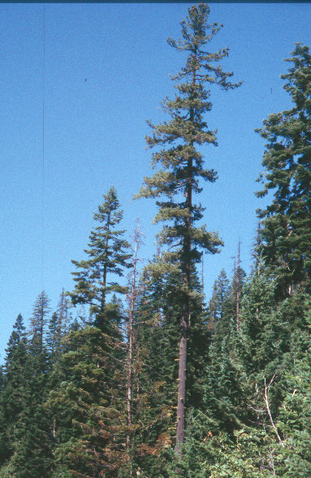
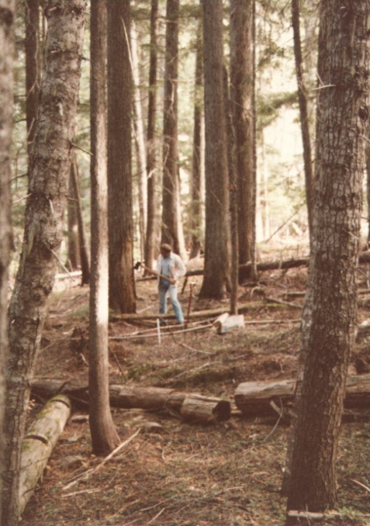
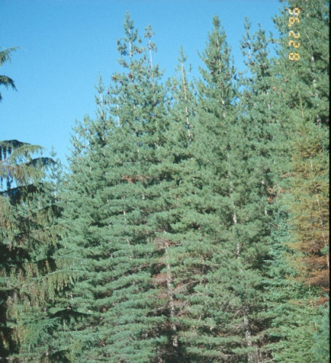
Initiation
Mid-aged
Mature
Structures &
Compositions
Young

Slide 9
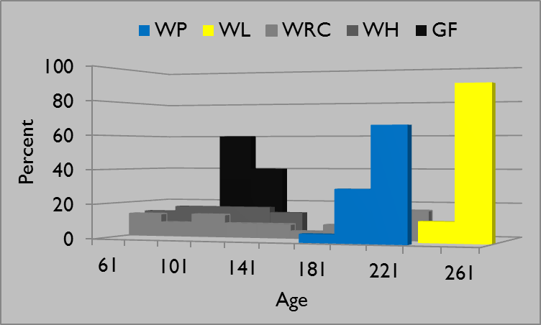
Bob Marshall (1928) All Aged – 2 fires 1480’s,1687

Slide 10
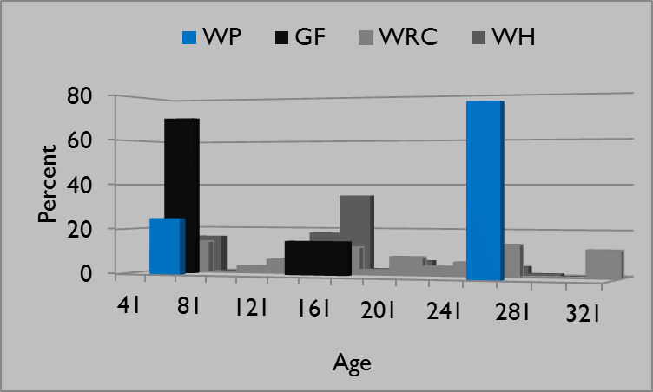
Bob Marshall (1928) Four Aged – 3 fires 1641, 1742, 1843

Slide 11
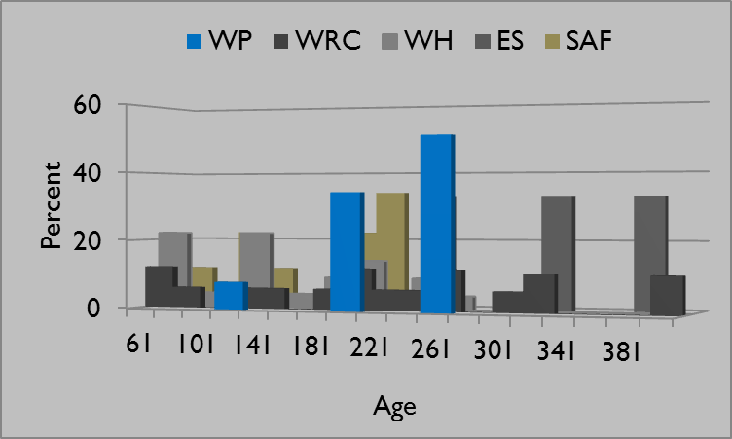
Bob Marshall (1928) River Bottom – 7 Age Classes

Slide 12
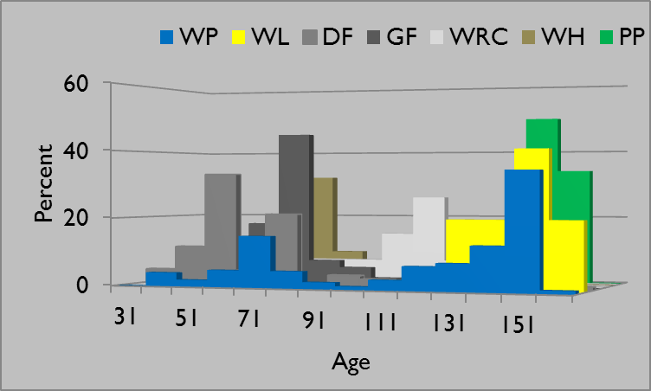
Bob Marshall (1928) Two-Aged – Entomological Variant

Slide 13
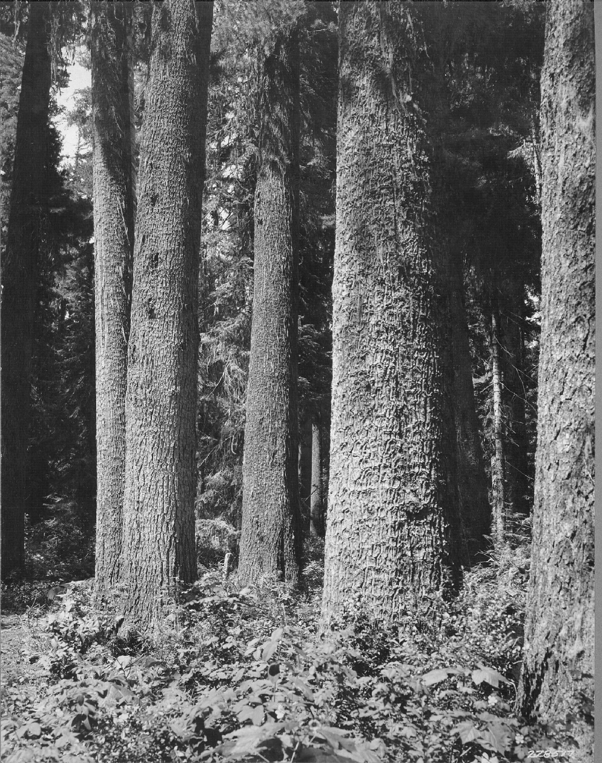
Western White Pine
Genetic generalist
High within stand variation
Low among strand variation

Slide 14
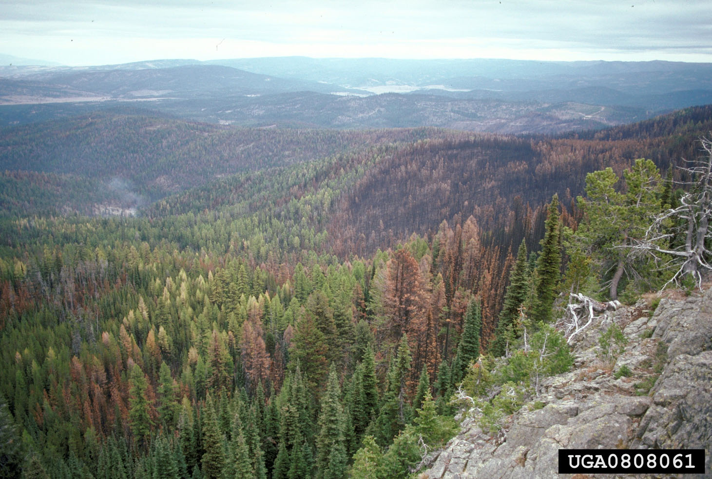
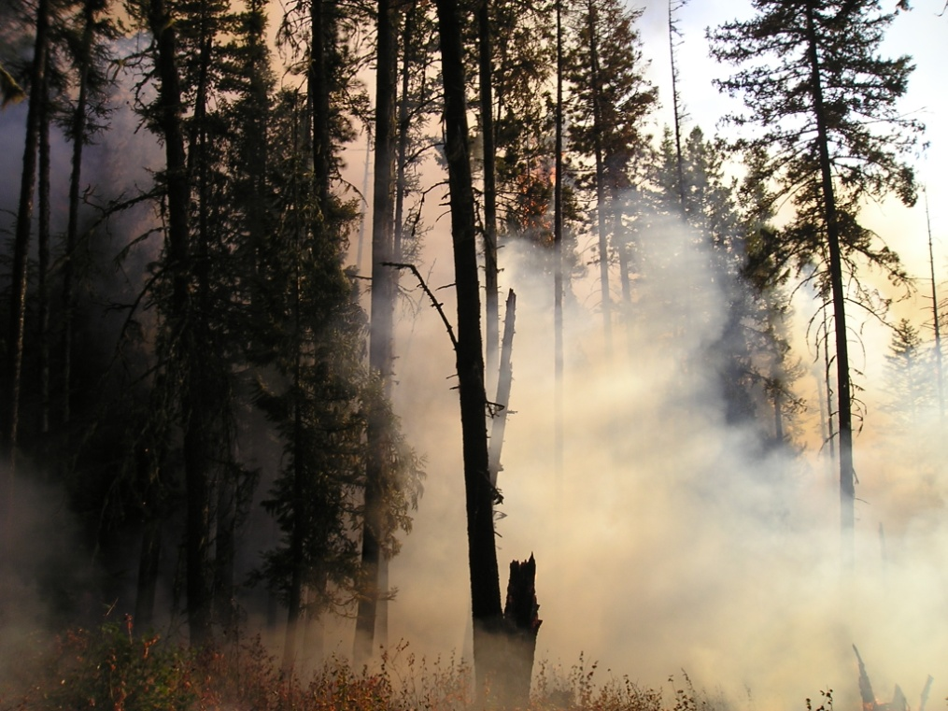
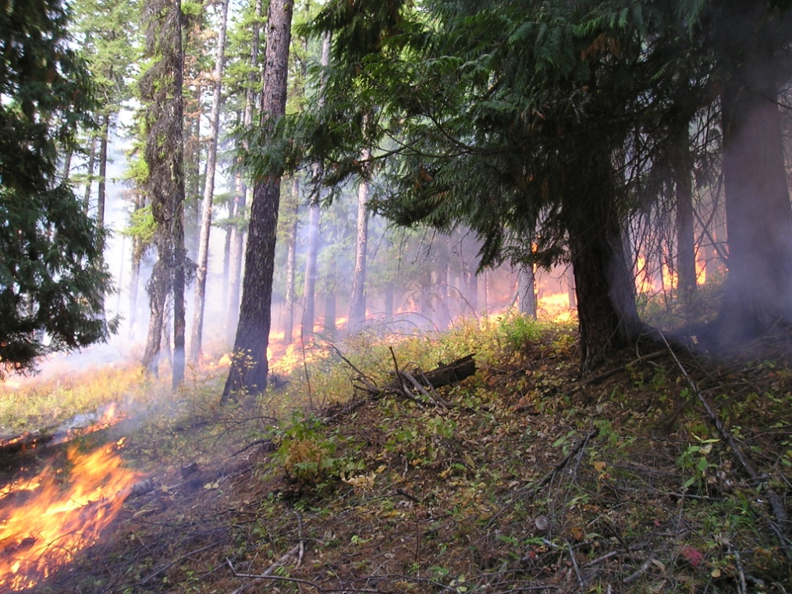
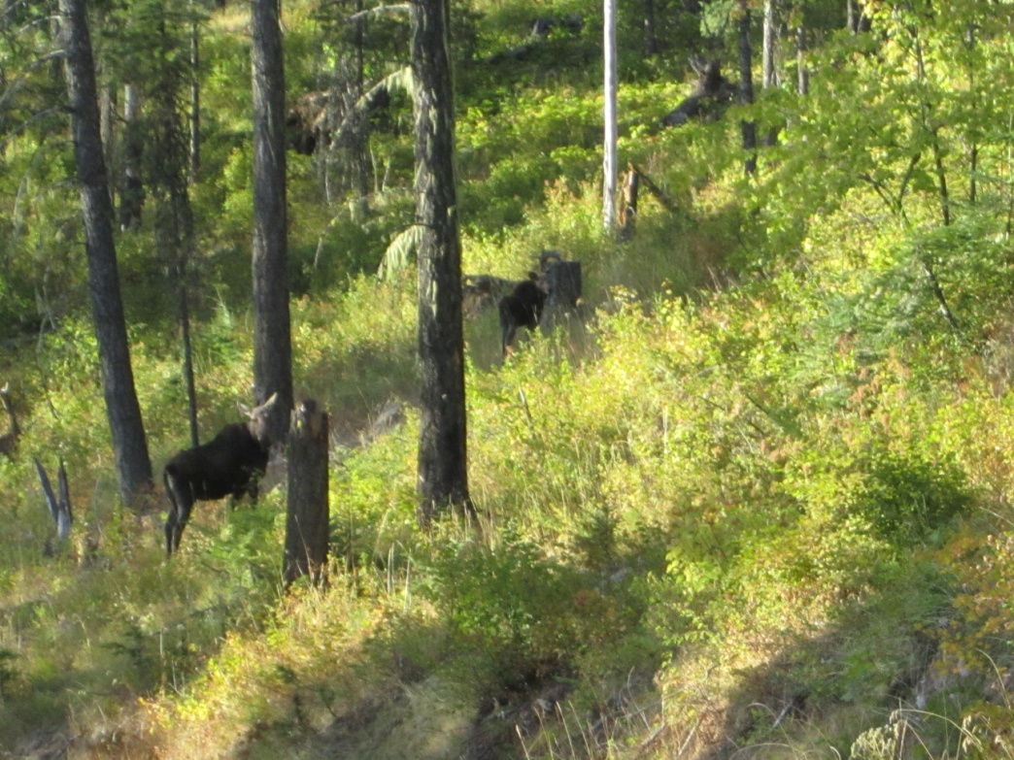
Mixed Severity
Low Severity

Slide 15
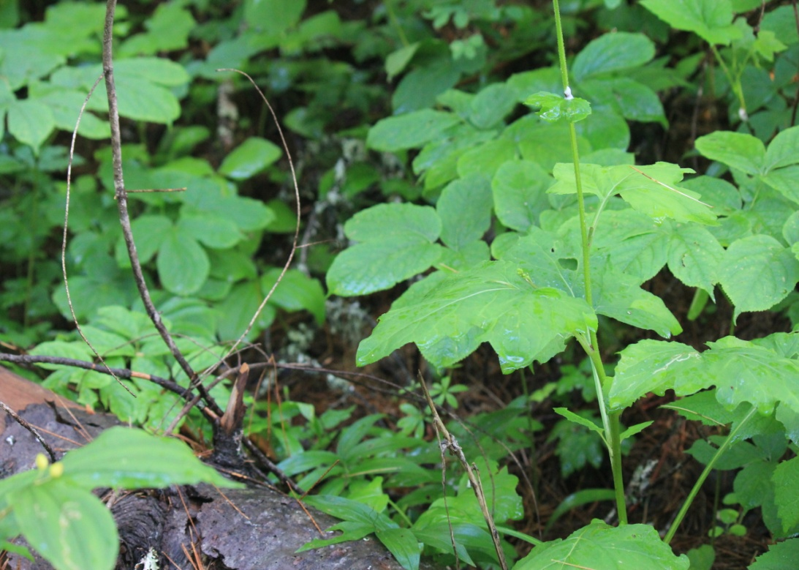
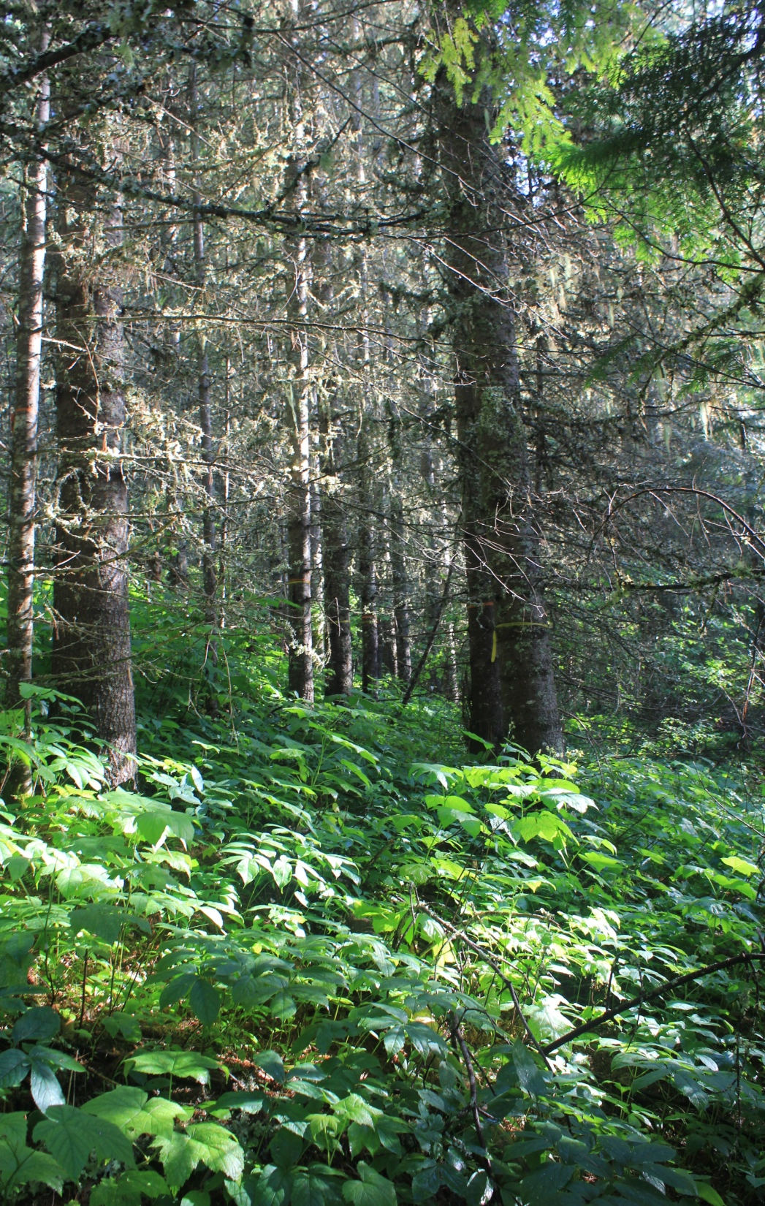
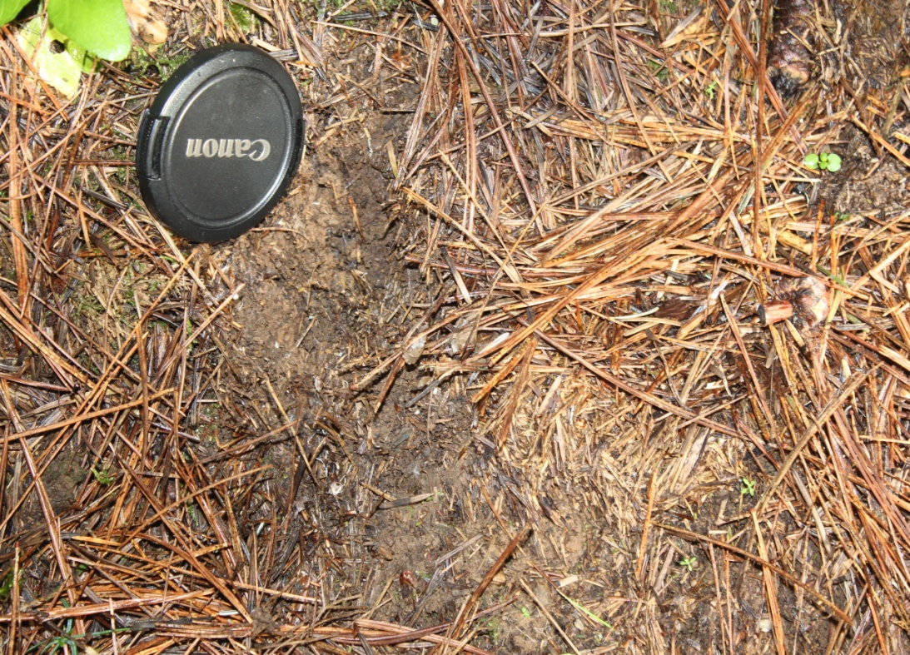
Fuel Matrix

Slide 16
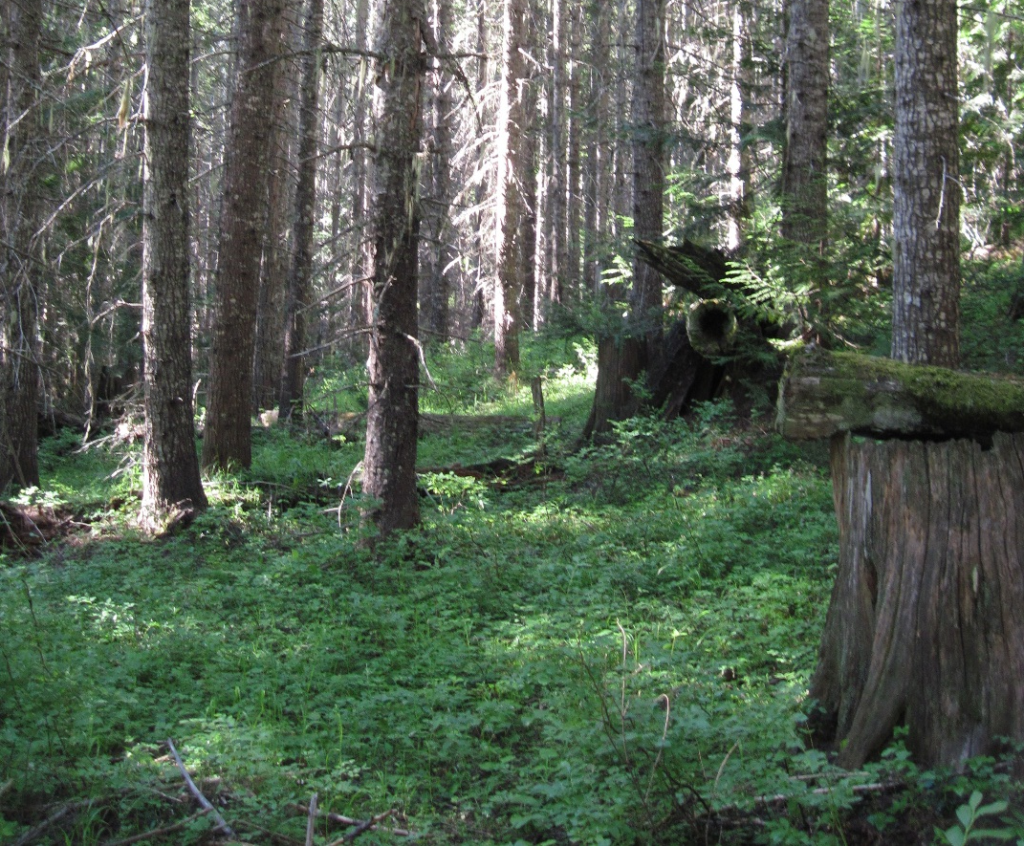
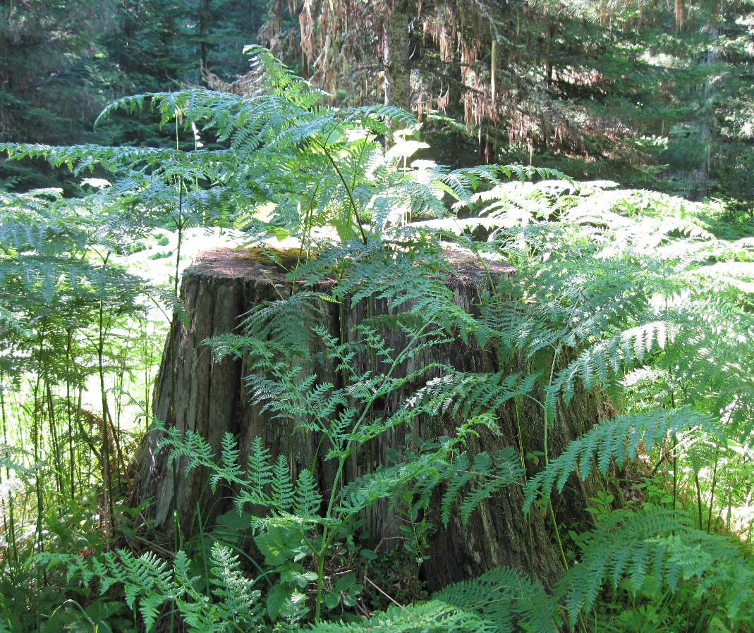
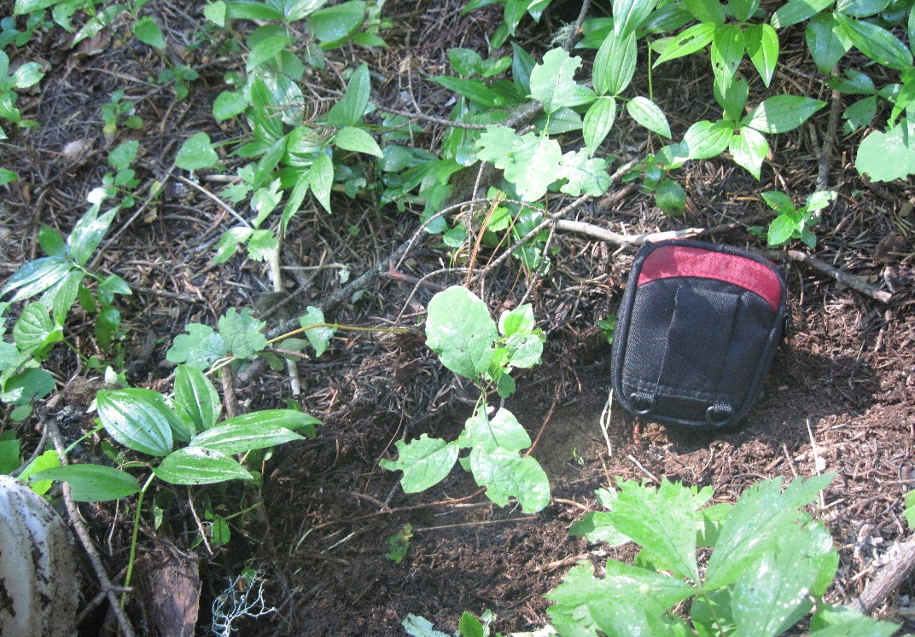
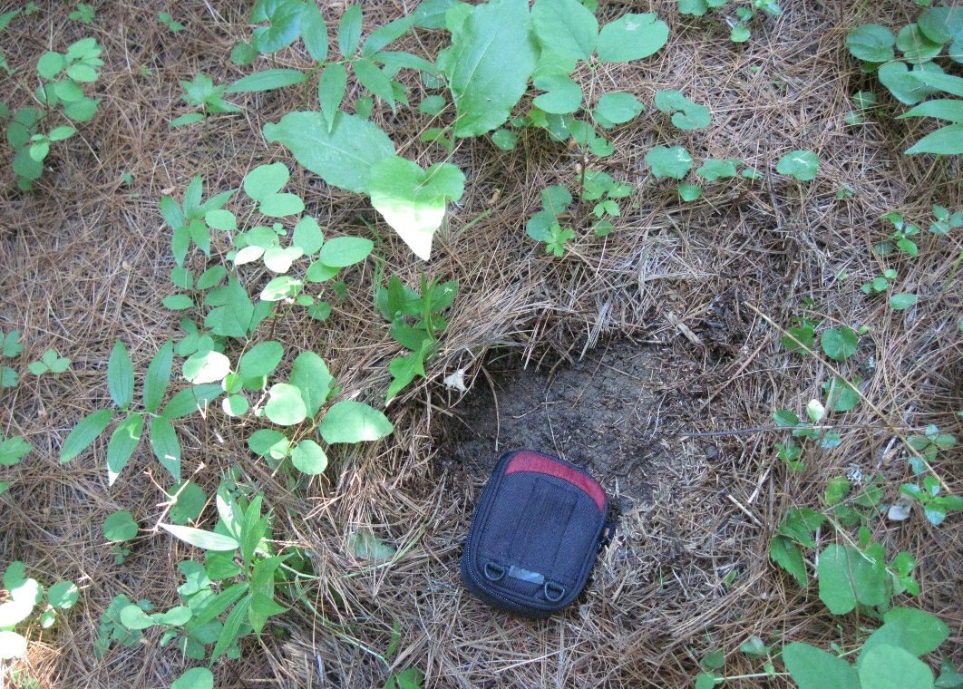
Fuels
Grand fir
White pine

Slide 17
Moist Habitat Types Priest River Are these fuel conditions real?

Slide 18
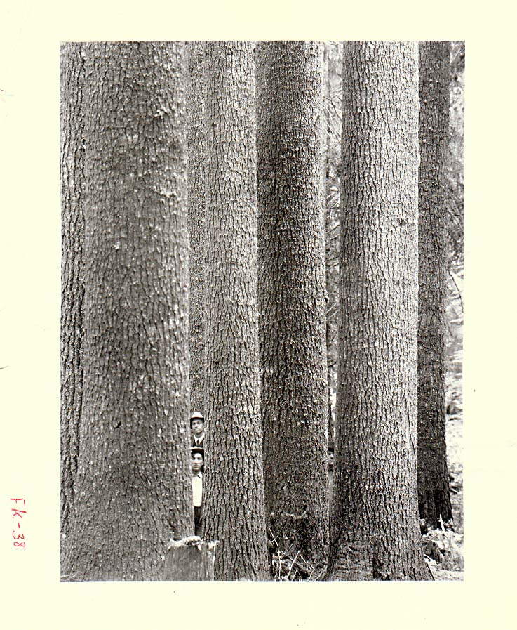
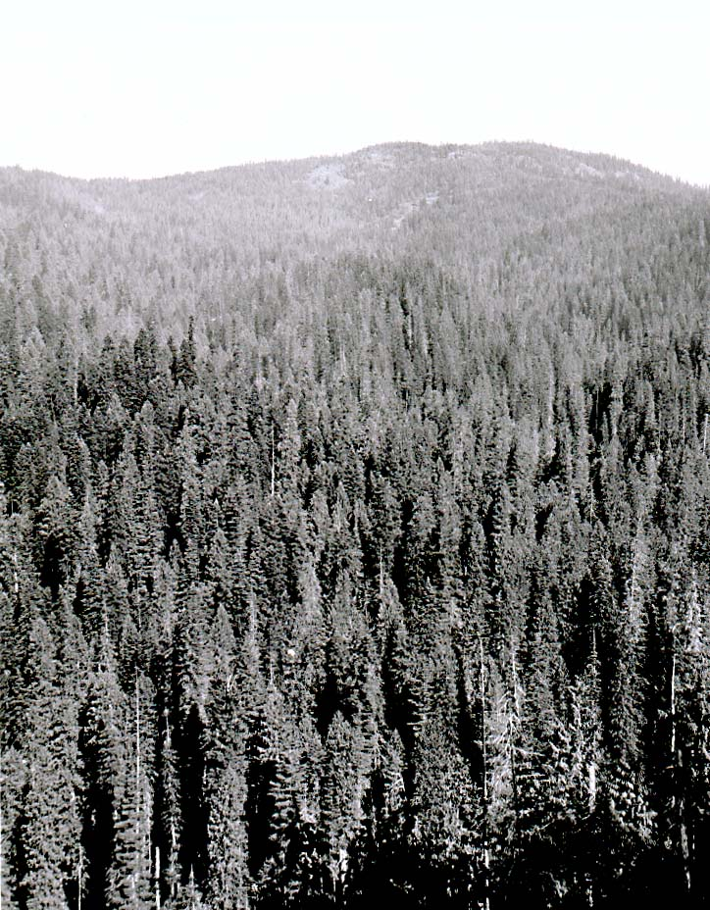

Slide 19
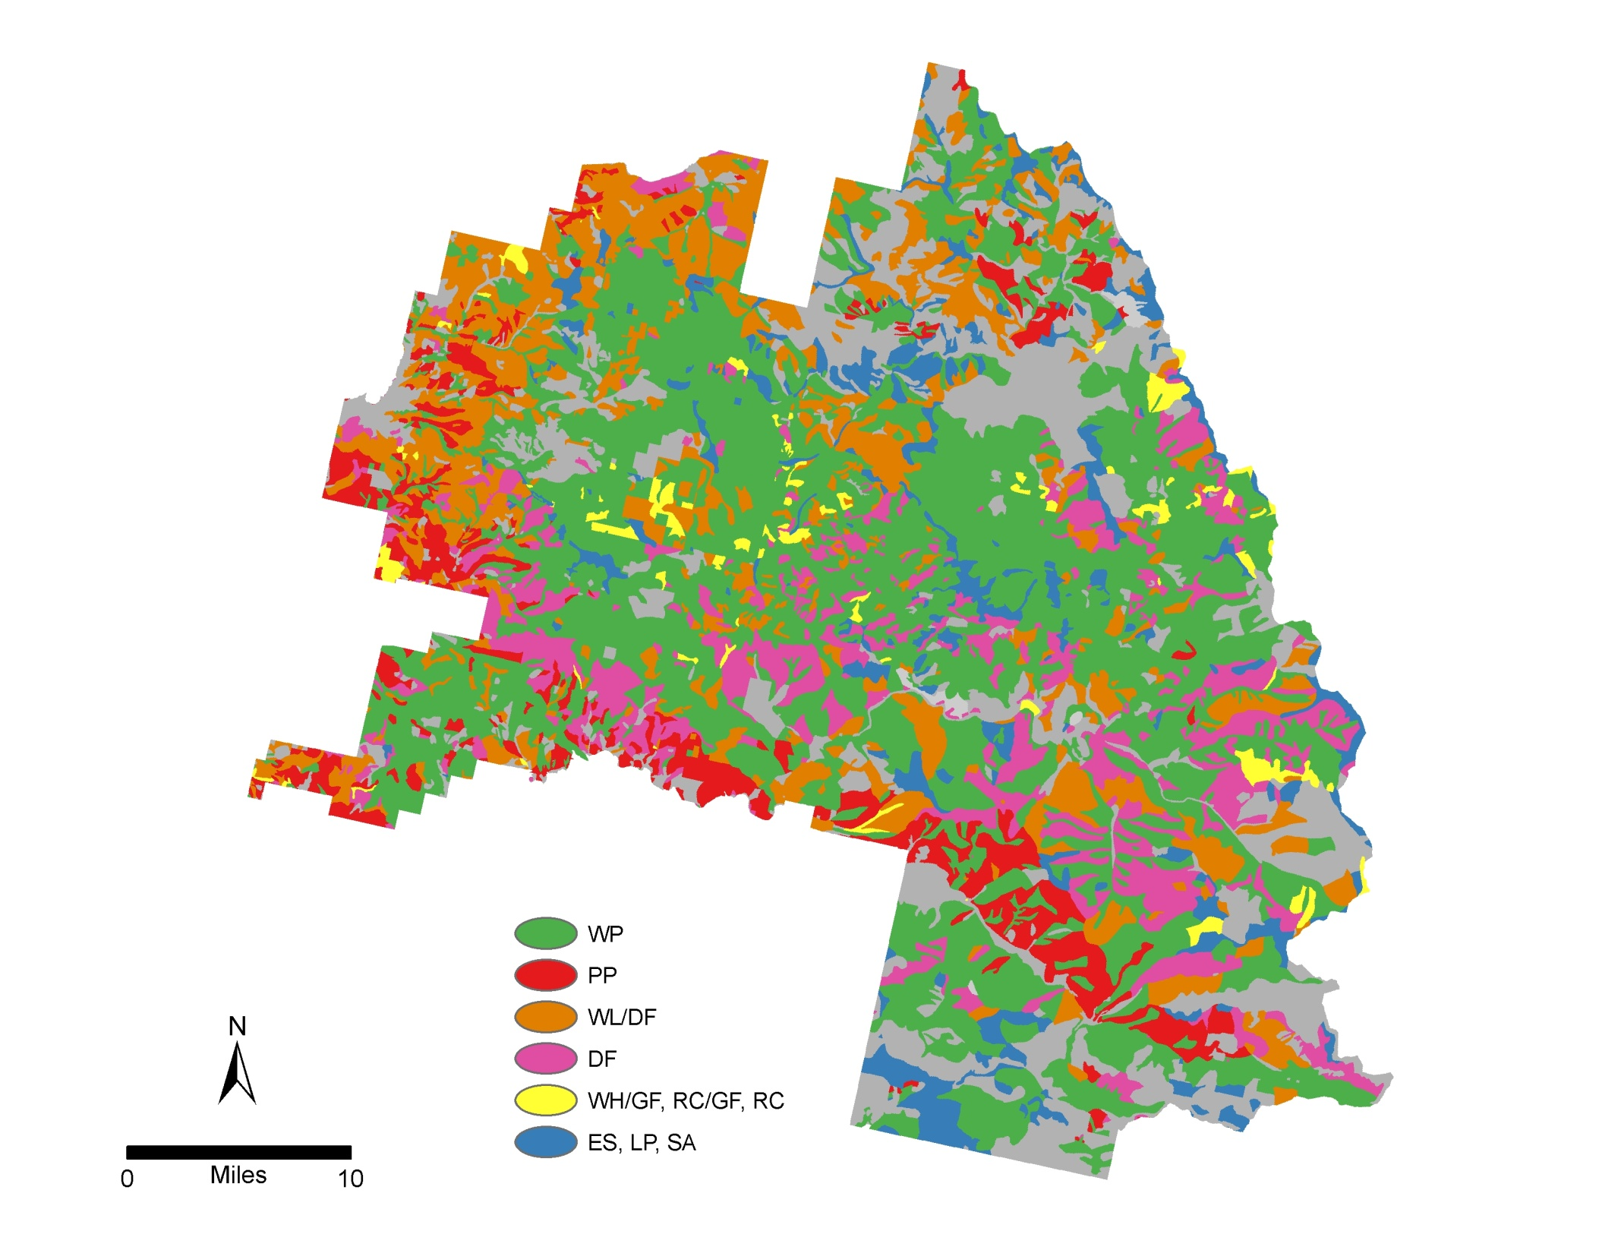
Coeur d’Alene
Ubiquitous
1934

Slide 20
Why Here? We do have some challenges
White Pine
1930’s
Today

Slide 21
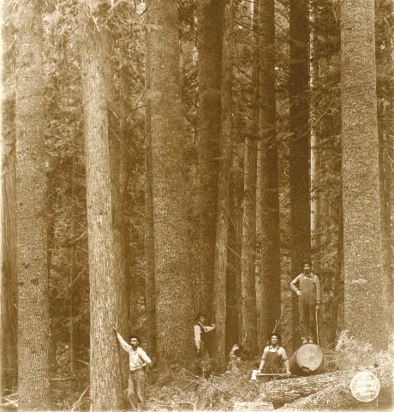
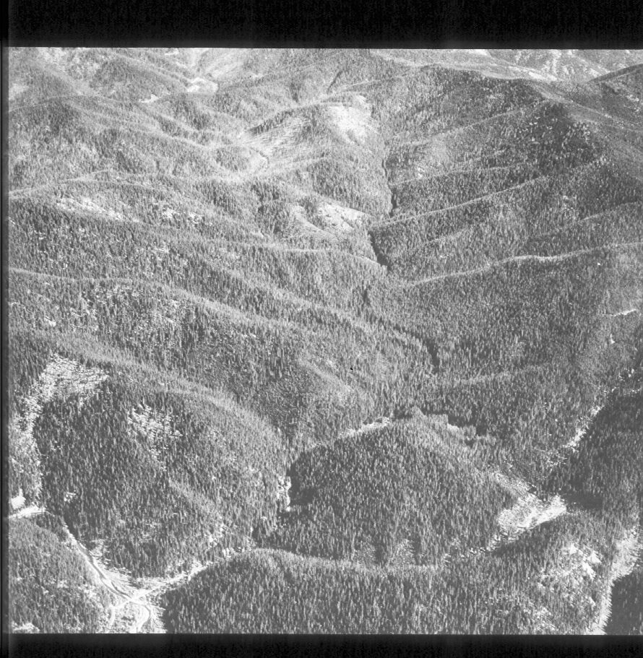
Factors that Changed the Moist Forests

Slide 22
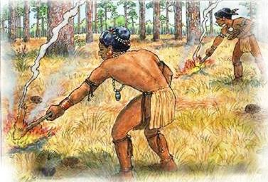
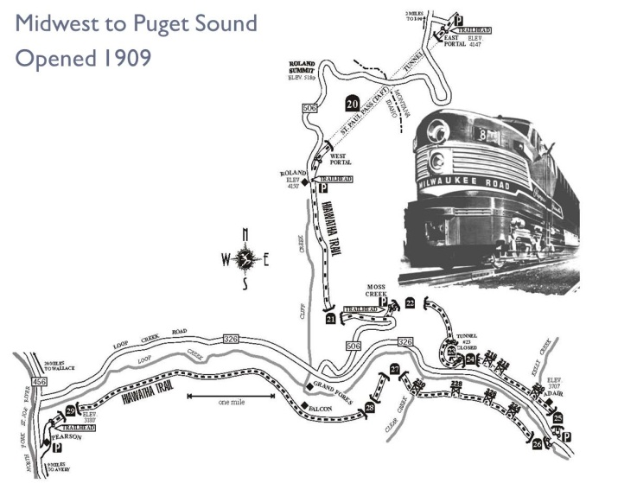
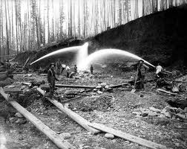
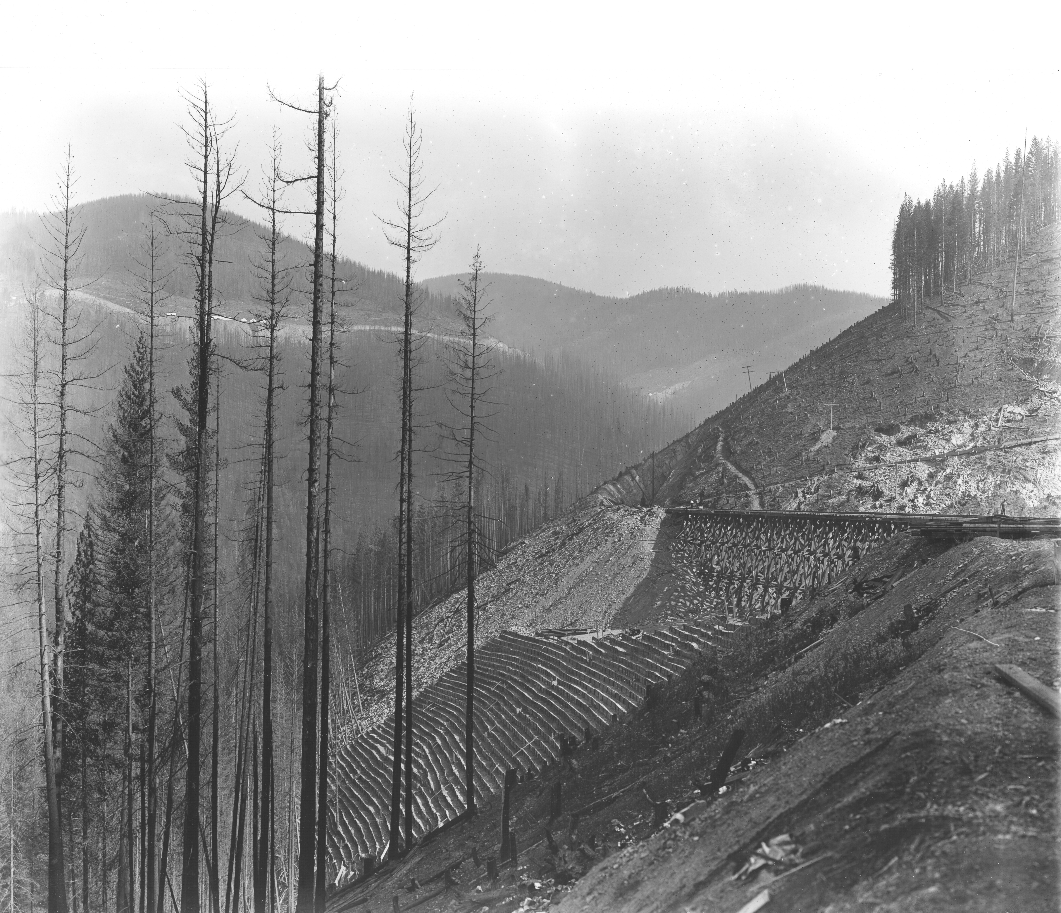
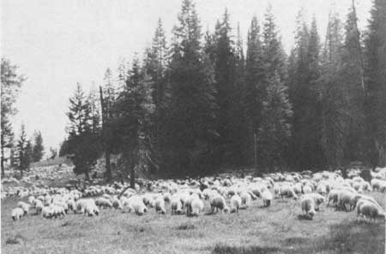
Human Impacts
Mining
1910 fire
Grazing

Slide 23
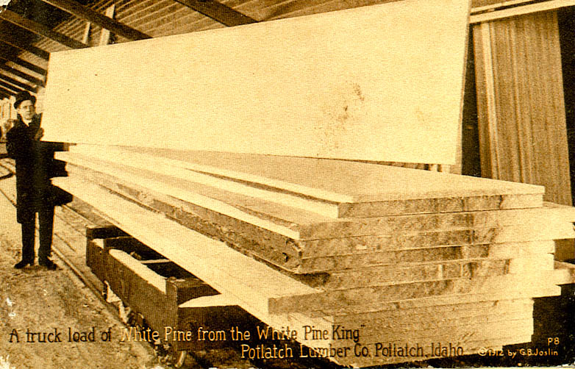
A Primary Reason for Industrial Growth Provided Access 1935-1938: 350 mmbf/year

Slide 24
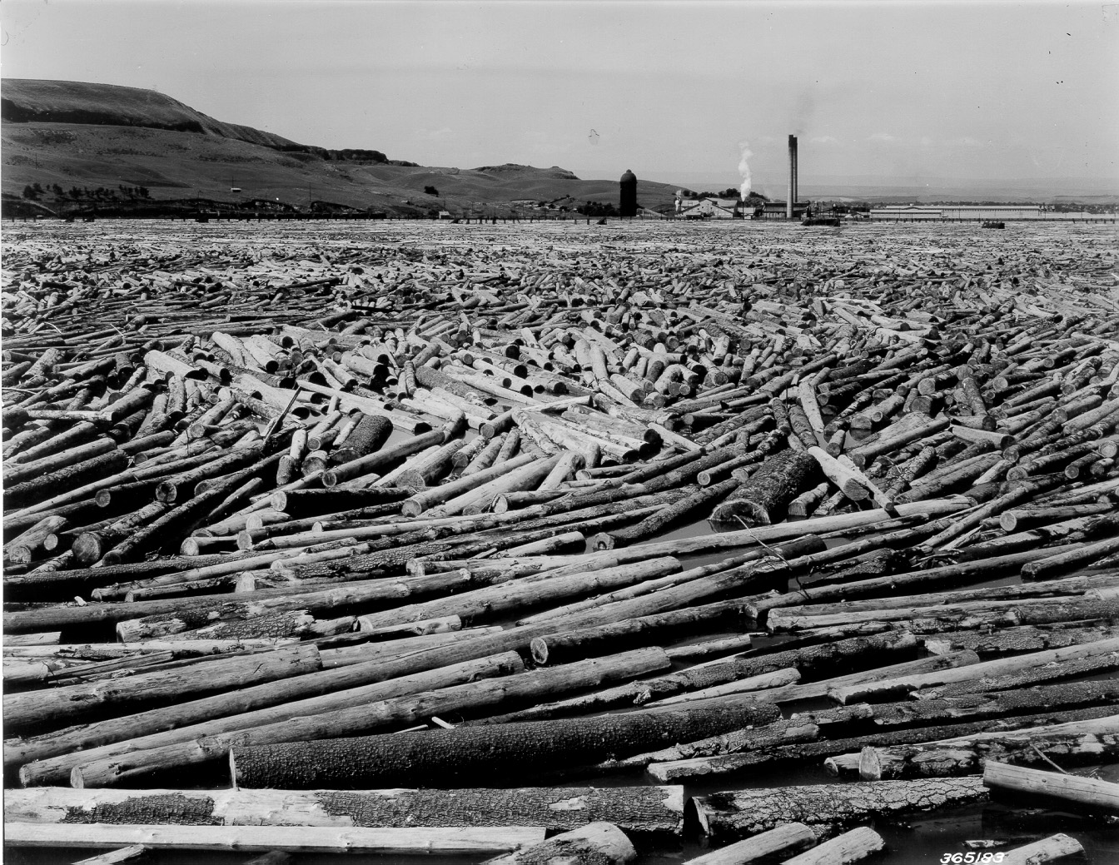
Largest White Pine Mill
35 Million Board Feet of White Pine
Lewiston, ID 1938

Slide 25
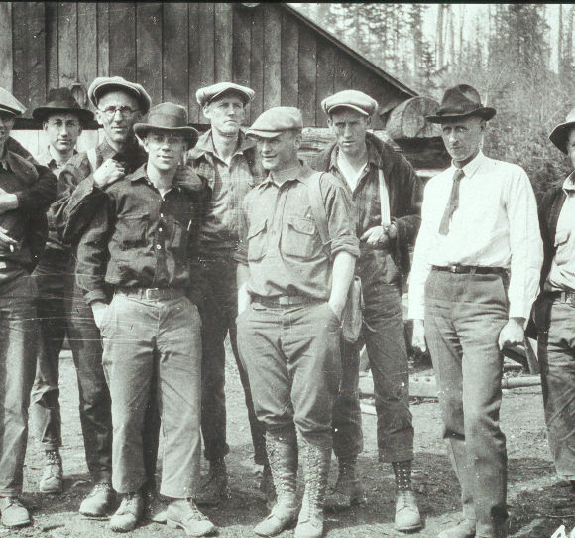
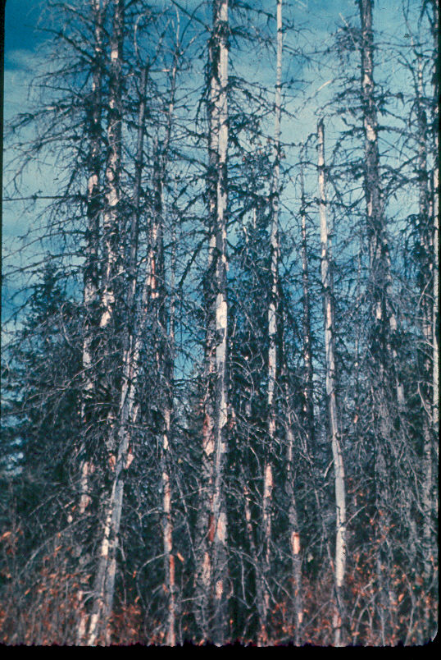
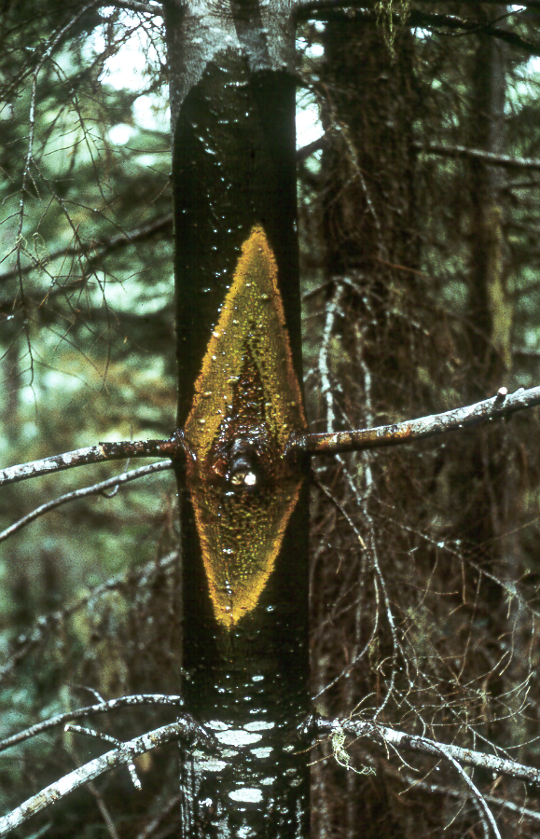
Decline from Western White Pine
Civilian Conservation Corp
Pulling Ribes
European disease introduced beginning of century
Like bailing the ocean with a tea cup
Blister rust

Slide 26
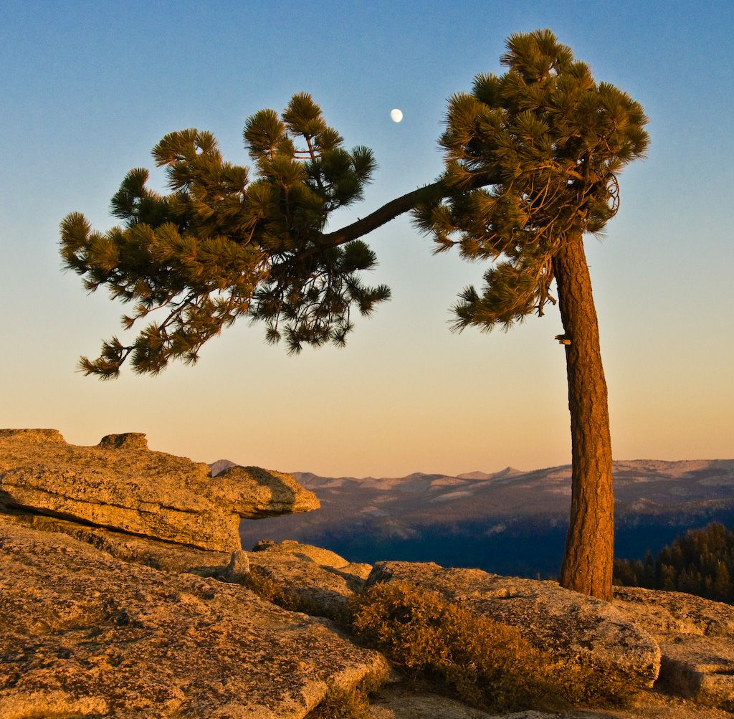
Resilient
Restoration
Resistant

Slide 27
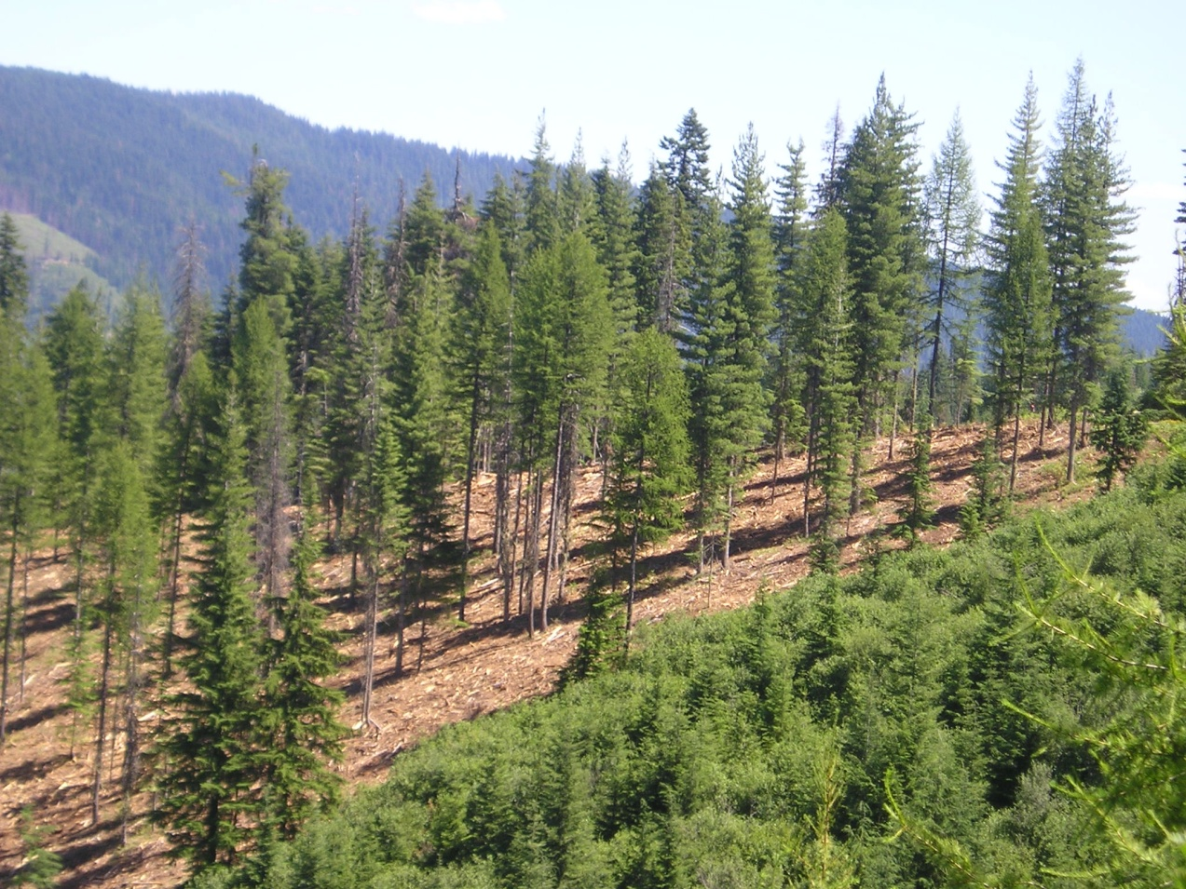
Natural
Selection
Rust
Resistant

Slide 28
1999
Demonstrates Resilience to Blister Rust

Slide 29
Restoration Efforts

Slide 30
Future – Moist Mixed Conifer Forests
Important to our society
Moist forests are diverse
Experienced a massive change
Disturbances operate differently
Wildlife habitat

Slide 31
Forests are
Important to People

Slide 32
Water
Wildlife
Their
Presence
Ponder

Slide 33
To
Enjoy

Slide 34
Randy Beachum
Livelihood

Slide 35
WWP Timber Potential
 | Haig 1932 | VQ actual
Site index base 50 | Max 80 | 120
Age 54 years
Trees/acre | 299 | 127
Mean height (ft) | 60 | 109
Height dominants (ft) | 87 | 123
Mean DBH (in) | 10.4 | 13.1
Mean DBH dominants (in) | 12.0 | 17.6
Basal area (ft²/ac) | 176 | 118
Volume (ft³/ac) | 6,322 | 4,446
Volume (bd ft/ac) | 21,720 | 23,935
Growth PAI (ft³/ac) | 180 | 141
Growth MAI (ft³/ac) | 95 | 83
Growth MAI (bd ft/ac) | 601 | 443
Culmination PAI (ft³/ac) | 55 yrs, 185 | 50 yrs, 181
Culmination MAI (ft³/ac) | 100 yrs, 154 | 79 yrs, 147

Slide 36
Opportunistic
Very Competitive
Fire Resistant
Not Competitive
Fire Resistant
Not Competitive
Early- to Mid-Seral Species

Slide 37
Old-growth Species
Ecology
Protected areas
Ancient tree
Generalist
Social & economic
Wood products
Very long-lived
Ponder value

Slide 38
Diversity
of
Forest Structures

Slide 39
Western White Pine Refugia
Beaver Creek

Slide 40
Assets

Slide 41
What do I need to be content?
Integrate with
Vegetation dynamics
Structure/composition
Fragmentation and edge
Connectivity
Woody debris
Snags
Wildlife

Slide 42
Dynamic Wildlife Habitats

Slide 43
Dynamic Landscapes
Notes:
Landscape diversity – I like this picture because it illustrates a mosaic of different conditions; just imagine this representing a Varity of post-fire environments; form everything still green such as the purple colors here; to stand replacing crown fire areas such as represented by the yellow flowers; and the orange flowers representing these orange fires a high intensity surface fire or brown trees

Slide 44
Treatment Placement

Slide 45
Focus Areas
Landscape
Silviculture
Young Forest
Management
Habitat and
Vegetation
Dynamics

Slide 46
Questions?
Comments?

